Slide 1
Agenda
Land Value vs Use
The Site
Landfill Understanding
Community Needs Assessment
Recommendations
Site Layout Options
Summary
Related Recommendations

Slide 2
Step 1. Land Value vs Use
Approach: Generate highest value to Wayland
Fulfill community’s current and future needs
Quality of life and fiscal

Slide 3
The Site
Alta Oxbow: 218 Housing Units
Area 2
Area I
Great Marsh National Wildlife Refuge
Two parcels: approximately 17 acres total
Area 1 (Parel 22-001): 10.65 acres, former landfill, w/4.4 acres of wetland to east
Area 2 (Parcel 22-002): 5.9 acres, higher ground, landfill history in question
Adjacent to Great Meadows Wildlife Refuge, Alta Oxbow, Sudbury line, & new trail

Slide 4
The Site
Alta Oxbow: 218 Housing Units
Area 2
Area I
Great Marsh National Wildlife Refuge
Except for landfill past, highest value Town property in western Wayland
Adjacency to wildlife preserve = views
Adjacency to future trail
High value key factor in calculus when weighing higher cost of redevelopment

Slide 5
Step 2. Understanding Landfill
Research indicates that more intensive future site development may not appear as difficult and costly as the Committee believes
Records show that only Area 1 was operated as a landfill up until 1980
According to a “Brief History of Wayland’s South Landfill” prepared in January 2021:
“The 1980 landfill closure date was long before the 22-002 parcel (Area 2) was put into mainstream service. The 500,000 cubic yards of “good gravel” was not removed from the 22-002 area. For the most part, that area remained unused for landfill purposes.”

Slide 6
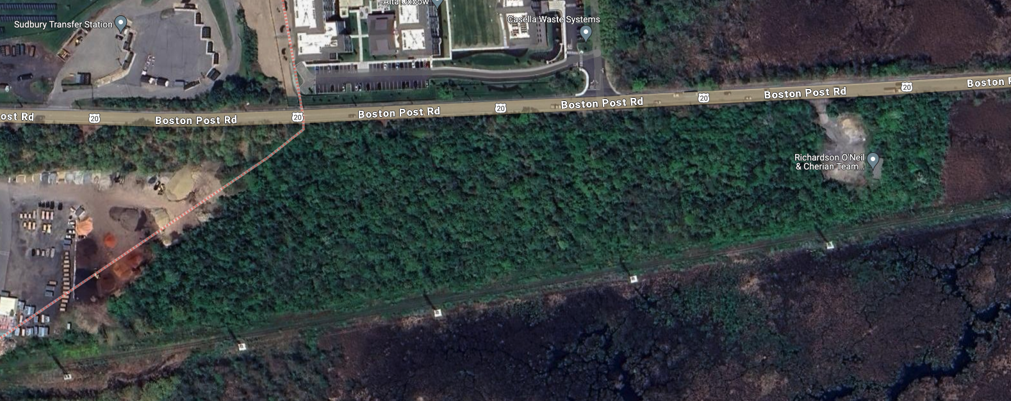
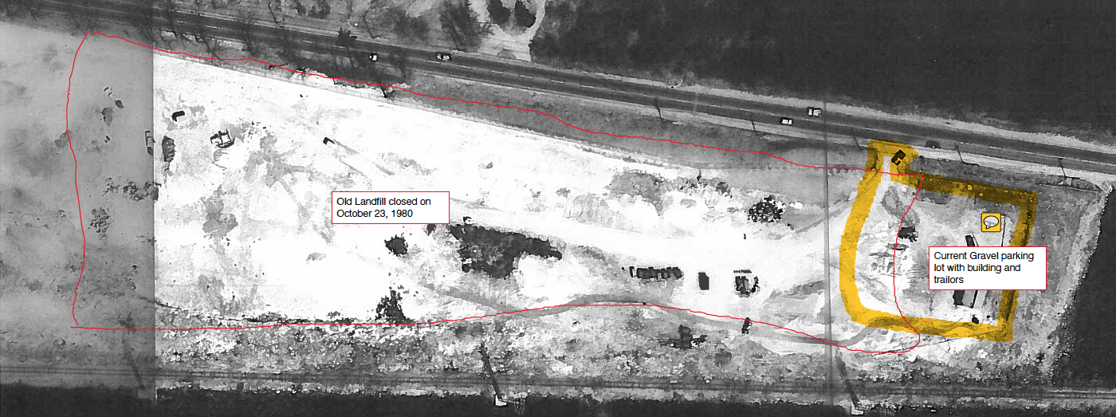
Aerial Photo of Wayland Landfill: 1977
Redline on drawing added later appears to delineate general boundary of landfill on Parcel 22-001

Slide 7
Step 2. Understanding Landfill
Apparently during capping process municipal waste moved from Area I to Area 2
to achieve moderate grade for erosion during a storm event
Additionally, apparently highest section of Area 2 not used to locate any cell for capped municipal waste, but was covered as part of the capping plan
Area 2
Area I
1 Cell
No Cells
14 Cells
No Cells

Slide 8
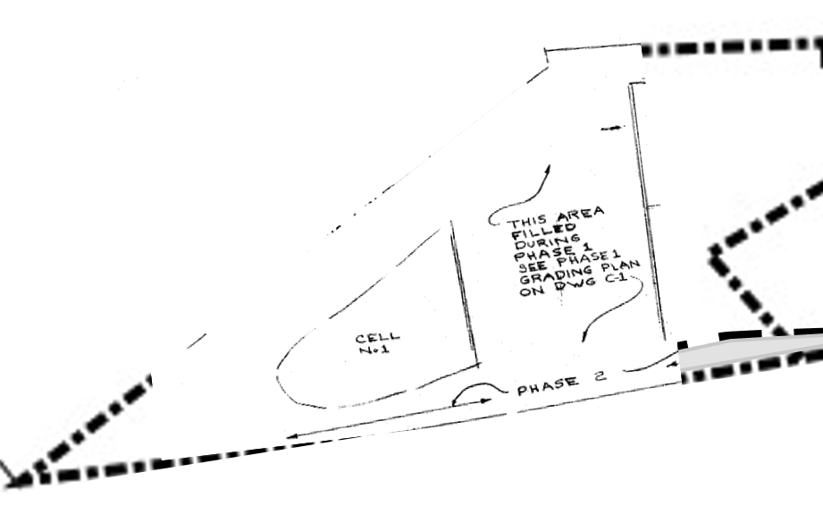
Step 2. Understanding Landfill
Apparently during capping process municipal waste moved from Area I to Area 2
to achieve moderate grade for erosion during a storm event
Additionally, apparently highest section of Area 2 not used to locate any cell for capped municipal waste, but was covered as part of the capping plan
Area 2
Area I
No Cells

Slide 9
Step 2. Understanding Landfill
Value to Town: Cost of addressing settlement associated w/constructing structures may be less due to significant weight of the site’s decades of tree cover

Slide 10
Redevelopment Costs
<$
$

Slide 11
Potential Land Uses
Lower-
Impact
Higher-Impact

Slide 12
Potential Land Uses
Lower-
Impact
Lower-Impact
Open Space
Paved Surfaces
Structures w/shallow foundations

Slide 13
Potential Land Uses
Higher-Impact
Higher-Impact
Buildings w/typical foundations
Paved Surfaces
Open Space

Slide 14
17 Uses for 17 Acres
Higher-Impact
Housing
Commercial
Town gateway
Lower-Impact
Conservation, birding
Vegetation borders
Design with nature
Fields
Trailhead for future trail
River access area
Amphitheater
Dog park
Highway materials recycling center
Shared parking 100 cars
School bus parking
Rest rooms
Solar generation
Waste-water leaching field

Slide 15
Community Needs Assessment
Interviews
Mike Scipion, P.E., Weston & Sampson
Tom Fay, Chair, Landfill Visioning Committee, Wayland Selectman
Tom Holder, P.E. DPW Director
Susan Bottan, Wayland Public Schools
Katherine Brenna, Wayland Recreation Department
Brian Boggia, Wayland Housing Authority
Becky Stanizzi, Wayland Economic Development Committee

Slide 16
Community Needs Assessment
Additional Research
2020 Census
Informal Commercial Development Analysis
Dog Park Assessment

Slide 17
Community Needs Assessment
General Findings
Highest Priority Needs
Housing:
Starter Homes: 7.6% between 25-34
55+ Housing: 35% of population
Supported Housing for Youth w/disabilities (WHA White Paper)
New MBTA Housing requirements (Wayland 50 acres rezoning)
Secondary Priority
Recreation: especially informal playing fields for soccer/lacrosse
Tertiary Priority
Materials Handling: approximately 1 ac minimum needed
Bus Parking: 20 spaces ideal

Slide 18
Recommended Strategy
Two Phase Approach
Phase 1:
Area 1: Recreation w/poss. materials handling
Area 2: Housing, esp. starter homes & 55+
Phase 2:
Area 1: Landbank to meet future housing needs

Slide 19
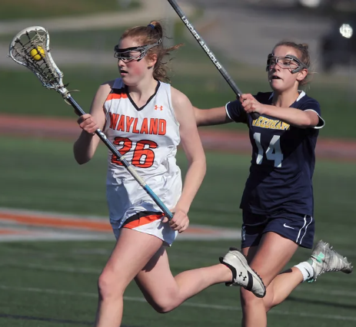
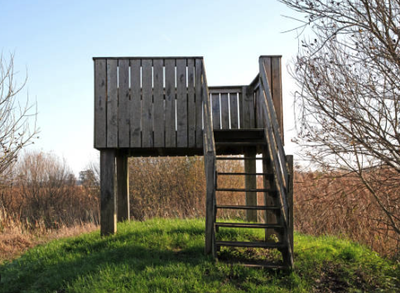
Area 2
Area 1
2.5 ac
Area 1 Recreation Focus
Playing field
Paths
Marsh and scenic overlook
Other:
Materials Handling?
Bus parking?

Slide 20
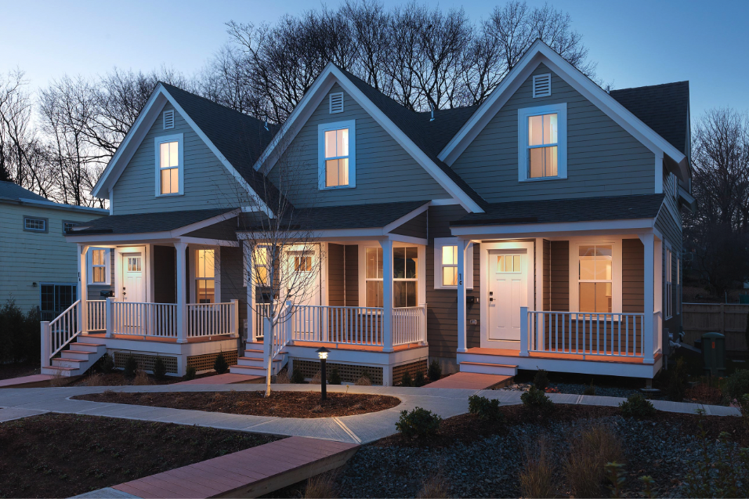
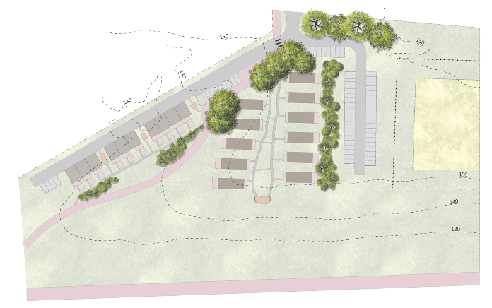
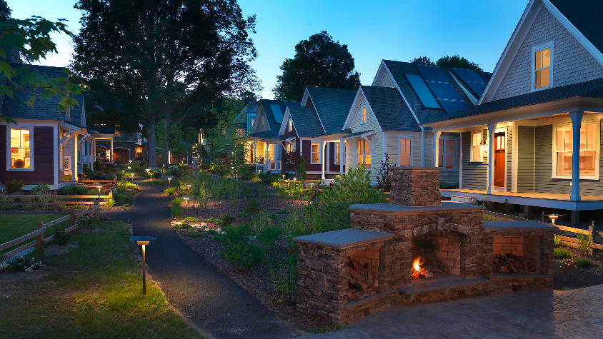
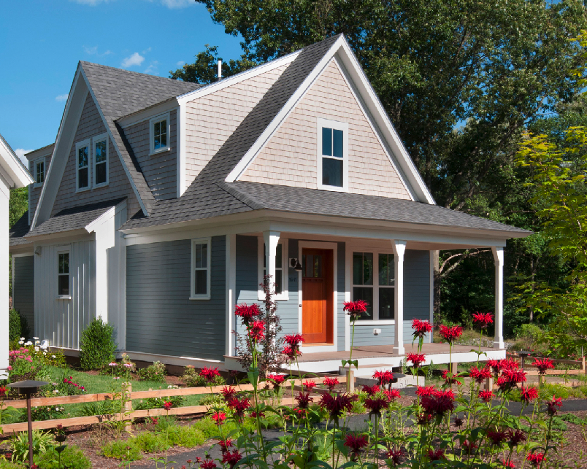
Area 2
Area 1
2.5 ac
Area 2 Housing:
2.5 acres = 21 units
Buffered edges, esp. along marsh & path
Birding and scenic lookout
10 starter homes: 1000 s.f.
Riverwalk Concord
11 age restricted homes: 13-1700 s.f.

Slide 21
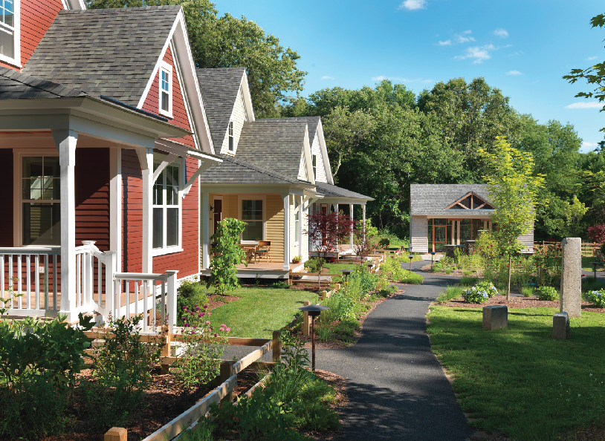
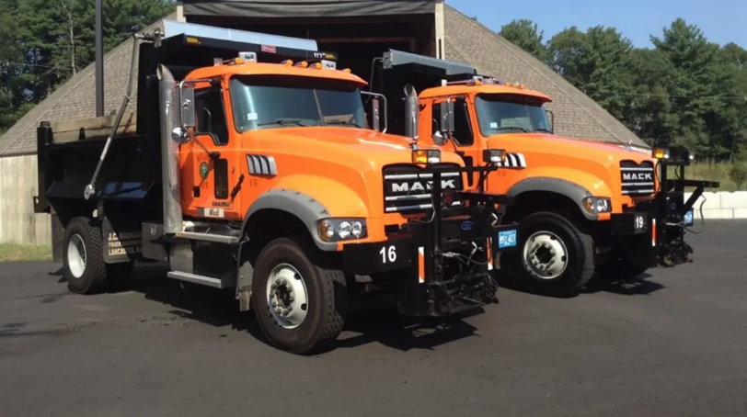

Slide 22
Summary
Recommend Two Phase Approach
Phase 1:
Area 1: Recreation w/poss. materials handling
Area 2: Housing, esp. starter homes & 55+
Phase 2:
Area 1: Landbank to meet future housing needs

Slide 23
Related Recommendations
Leverage value: Access to new trail, Alta Oxbow, and new recreation Area
Surplus capped 25-acre landfill to north (current transfer facility) for housing, especially starter homes and 55+
Connect area with trail system
Work w/MassDOT & Sudbury to build sidewalks along Route 20
Find in-town site for Supported Housing for Youth w/disabilities

Slide 24
Discussion

Slide 25
