Slide 1

Fiscal Year 2025 Omnibus Budget
Proposed Operating and Capital Budgets and 5-Year Capital Plan
Finance Committee Presentation to Select Board
April 29, 2024

Slide 2
Agenda
Finance Committee Mission & Strategy
FY25 Budget Environment & Budget Drivers
Proposed FY25 Operating Budget and Tax
Proposed FY25 Capital Budget and 5-Year Capital Plan
Finance Committee Recommendations
Questions

Slide 3
Mission and Strategy
Mission: define a financial strategy for the Town to use as basis for recommending a fiscally responsible operating and capital budget to Annual Town Meeting
Strategy: balance the demand for services, by a community with multiple needs and desires, with the ability of residents with a broad range of financial situations to afford those services

Slide 4
FY25 Budget Environment
Challenges Facing FY25 Budget and Beyond:
  Approaching Prop 2 ½ Overrides in FY26 and/or FY27 as Levy Cushion Depletes
  Continued Inflationary Environment
  Collective Bargaining Agreements completed (FY24-FY26; most Town/Teachers’ unions) at higher Cost of Living Adjustment levels than for prior contracts
  Adopting Tuition-Free Full Day Kindergarten - to be funded with ARPA Funds in FY25
  Need to Address Water Infrastructure / Significant Capital Investment - HS Wastewater in near-term; other infrastructure needs in medium/long-term
  Relatively Flat State Aid

Slide 5
FY25 Operating Budget: Budget Drivers
Town and Schools
  Settlement of 8 collective bargaining agreements (est. $1.7M COLA)
Schools Non-Payroll expenses (+$431K); primarily due to new Transportation contracts
Addition of 3.8 FTEs for Town ($231K)
Rising Benefit costs - Healthcare ($975K) and Retirement ($378K)
Increase in Energy cost ($111K)
Note: FY26 will be first year of FDK being fully funded through the Operating Budget
Transition to Tuition-Free FDK ($536K) to be funded with ARPA funds in FY25

Slide 6
FY25 Operating Budget
(Guideline of “Level Services”)
* In FY23, Energy/utilities expenses were allocated to the Town and Schools lines with a combined $1.597M total.
**FY24 Approved budget has been restated to reflect the allocation of $1.189M to Schools from Salary Reserve following the Special Town Meeting vote in December 2023 approving the transfer of funds for WTA and WESA settlements.
“FY25 vs FY24 Allocated” includes the allocation of FY24 Reserves for Sal Adj to the Town and Schools Personnel line items pursuant to CBA settlements.

Slide 7
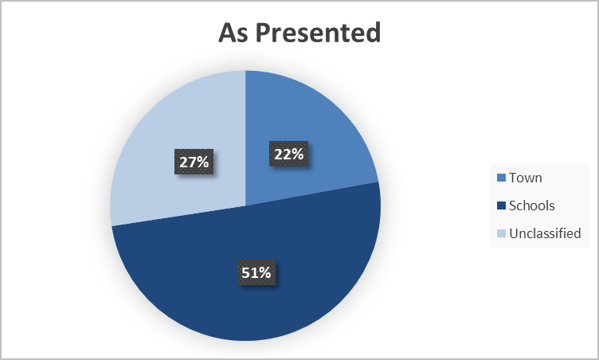
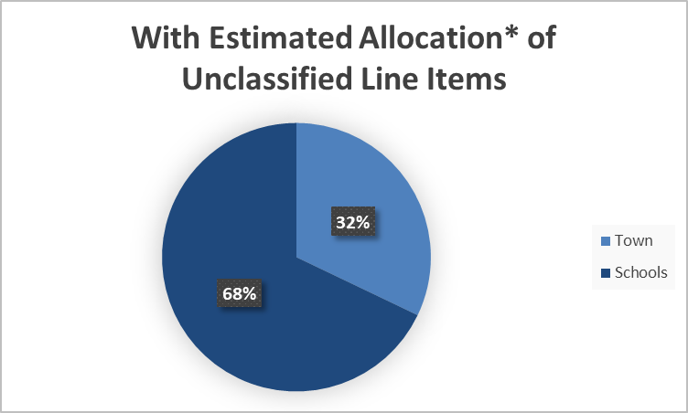
FY25 Operating Budget: Composition
*Retirement and Health Insurance, General Insurance, Medicare and Reserve Fund allocated 30%/70% to Town/Schools, respectively. The Town Payroll/Total Payroll ratio is forecasted at 28% for FY24 and FY25 .

Slide 8
FY25 Operating Budget: Sources and Uses of Funds
Funded with Free Cash
Small Increase YoY
Lower than FY24

Slide 9
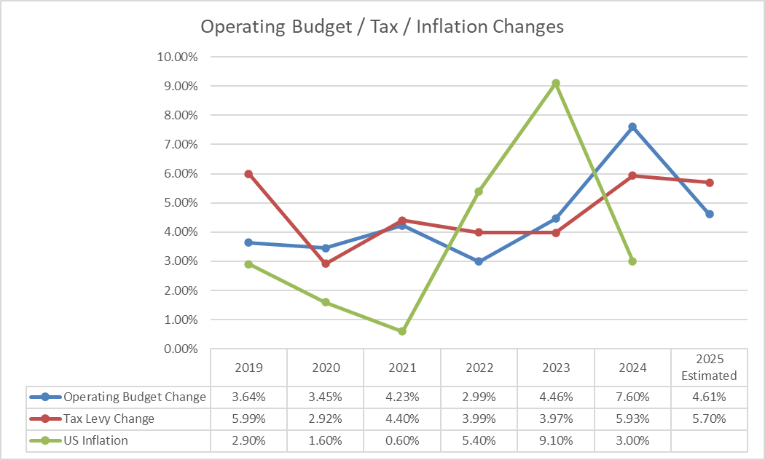
Recent Budget Trends
US Inflation is average monthly change in CPI for the prior year period; e.g., FY24 Inflation of 3% is average monthly increase from July 2022-June 2023.

Slide 10
FY25 Capital Budget-By Department

Slide 11
FY25 Capital Budget
Recommended Capital | FY25 | Guideline
Cash Capital (CC) Taxation in Current Year | $0 | $600-800K
Free Cash (FC) No Impact on Tax Levy | $2,109,661 | $1.5-2.0M
Surplus Capital No Impact on Tax Levy | $75,209 | No GL
Non-exempt Debt (LD) Taxation - payments spread over up to 20 years | $1,354,577 | $3.0-5.0M
Exempt Debt (ED) Taxation-payments spread over up to 20 years not subj. to Prop 2 ½ | $0 | No GL
Ambulance Receipts (AMB) No Impact on Tax Levy | $279,000 | $200-300K
Water Debt No Impact on Tax Levy – Impact on customers | $3,830,000 | No GL
Total | $7,648,447

Slide 12
FY25 Capital Projects
See Warrant, Article 10 for detailed description of projects

Slide 13
5-Year Capital Plan
Does not include plan for Water infrastructure expense as plan is TBD.
Does not include Recreation (fields) or De-Carbonization projects ($11.6M identified).
Capital requests totaled approximately $88.5MM including estimated $20M for MWRA project.

Slide 14
Levy Limit and Levy Capacity

Slide 15
Recommendations
Prepare for FY26 and/or FY27 Operating Override
5 Year Operating budget projections, forecasting software
Review Town Operations/Processes (adhoc committee/working group) for efficiencies
Engage in Strategic, Long-term Capital Planning (e.g. 10-20years)
Manage Capital Projects to ensure timely completion
Encourage Most Efficient Investment of Town Assets, including Debt Proceeds (Cash)
Consider Inter-Municipal Cooperatives with other Towns - Utilities/Other Purchases
Consider Medicare Buy-In for Retirees
Formulate Strategic Long-Term Plan for OPEB Spending
Evaluate Hiring Practices to Mitigate Financial implications (Settlements)
Study Transfer Station Viability

Slide 16
Questions

